Slide 1



Notes:
Hello, in this presentation we will develop our first Provengo model <break time="0.5s"/>, visualize it’s test-space, and run it.

Slide 2
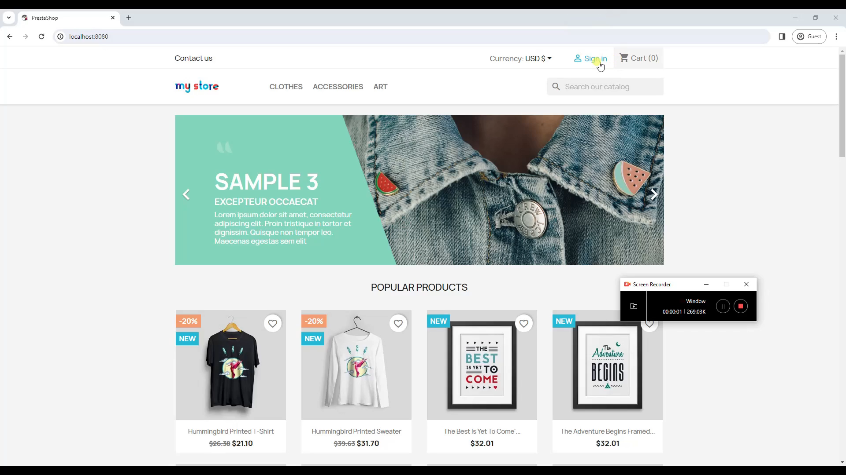
bthread("", function () {
sync({ request: Event('Login', { email: 'bob.marley@provego.com', password: 'ishotthesherif' }) });
sync({ request: Event('AddProductToCart', { name: 'HUMMINGBIRD PRINTED T-SHIRT' }) });
sync({ request: Event('AddProductToCart', { name: 'HUMMINGBIRD PRINTED SWEATER' }) });
sync({ request: Event('Checkuout', { defaultAdress: true, defaultPaymentMethod: true }) });
})
Notes:
We begin with a simple model in Provengo that specifies that we want to simulate a user who logs into the system, adds two products to the shopping cart, and checks out. The expected outcome is illustrated in the video we see here, and the model itself is shown in the text below it. We will, next, explain the model and show how it can be used.

Slide 3
bthread("", function () {
sync({ request: Event('Login', { email: 'bob.marley@provego.com', password: 'ishotthesherif' }) });
sync({ request: Event('AddProductToCart', { name: 'HUMMINGBIRD PRINTED T-SHIRT' }) });
sync({ request: Event('AddProductToCart', { name: 'HUMMINGBIRD PRINTED SWEATER' }) });
sync({ request: Event('Checkuout', { defaultAdress: true, defaultPaymentMethod: true }) });
})
Notes:
At the top level of a Provengo model, we specify the threads of behaviors called b-threads that describe the paths we want to simulate in our testing. In this example, there is only one b-thread because we only want to simulate one sequential behavior. The b-thread construct takes two parameters: the name of the b-thread, which is just an empty string in this example, and a function that describes what we want the b-thread to do.

Slide 4
bthread("", function () {
sync({ request: Event('Login', { email: 'bob.marley@provego.com', password: 'ishotthesherif' }) });
sync({ request: Event('AddProductToCart', { name: 'HUMMINGBIRD PRINTED T-SHIRT' }) });
sync({ request: Event('AddProductToCart', { name: 'HUMMINGBIRD PRINTED SWEATER' }) });
sync({ request: Event('Checkuout', { defaultAdress: true, defaultPaymentMethod: true }) });
})
Notes:
The function of the b-thread, in our example, invokes the sync construct four times. This construct allows the b-thread to synchronize with the other b-threads and specify the test’s next step.

Slide 5
bthread("", function () {
sync({ request: Event('Login', { email: 'bob.marley@provego.com', password: 'ishotthesherif' }) });
sync({ request: Event('AddProductToCart', { name: 'HUMMINGBIRD PRINTED T-SHIRT' }) });
sync({ request: Event('AddProductToCart', { name: 'HUMMINGBIRD PRINTED SWEATER' }) });
sync({ request: Event('Checkuout', { defaultAdress: true, defaultPaymentMethod: true }) });
})
Notes:
In Provengo, test steps are termed as ‘events’. Each event possesses a name, given as the first parameter, and a data object, given as the second parameter. In our scenario, the b-thread sequentially triggers four events, mirroring the user steps we aim to simulate in our test.

Slide 6
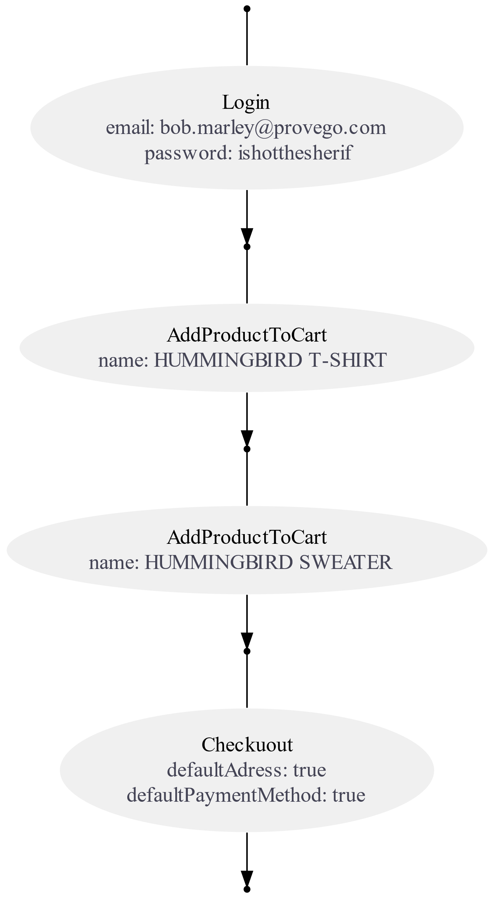
Run the command:
$ provengo create first-model
Use a text editor to replace the content of first-model/spec/js/hello-world.js to:
bthread("", function () {
sync({ request: Event('Login', { email: 'bob.marley@provego.com', password: 'ishotthesherif' }) });
sync({ request: Event('AddProductToCart', { name: 'HUMMINGBIRD PRINTED T-SHIRT' }) });
sync({ request: Event('AddProductToCart', { name: 'HUMMINGBIRD PRINTED SWEATER' }) });
sync({ request: Event('Checkuout', { defaultAdress: true, defaultPaymentMethod: true }) });
})
Run the command:
$ provengo analyze --style full -f pdf first-model
The default output is first-model/products/run-source/testSpace.pdf
The tool creates a visualization that shows all the possible test paths in the model
Notes:
To visualize the model in action, we can create a test project and input our model into it. Then, we can use the ‘analyze’ command in Provengo to generate a graphical depiction of all the test paths within our model. If you have Provengo installed on your system, you’re welcome to try these commands on your own. For this basic model, the graph is a single path because we only specified one sequence of steps.

Slide 7
$ provengo run first-model
/\
/XX\
{XXXX#####################################
\XX/ / _ \_______ _ _____ ___ ___ ___
\/ / ___/ __/ _ \ |/ / -_) _ \/ _ \/ _ \
/_/ /_/ \___/___/\__/_//_/\_, /\___/
/___/
[SETUP] INFO Input path: /first-model
[RUN ] INFO Preparing to run
[RUN>random] INFO B-program started
[RUN>random] INFO Selected: [Login {JS_Obj email:"bob.marley@provego.com", password:"ishotthesherif"}]
[RUN>random] INFO Selected: [AddProductToCart {JS_Obj name:"HUMMINGBIRD PRINTED T-SHIRT"}]
[RUN>random] INFO Selected: [AddProductToCart {JS_Obj name:"HUMMINGBIRD PRINTED SWEATER"}]
[RUN>random] INFO Selected: [Checkuout {JS_Obj defaultAdress:true, defaultPaymentMethod:true}]
[RUN ] INFO Test Result: SUCCESS
Notes:
We can also RUN the model. In Provengo, a model is executed by selecting a specific test path and sequentially triggering the events along this path. As we delve deeper into this course, we’ll discover that testers can associate actions with event triggering to implement test automation. We will also see later that Provengo’s capabilities extend beyond merely choosing random paths in the tree.

Slide 8
Notes:
This brings our presentation to a close. We’ve seen how models are created in Provengo and their structure and basic use.

